Slide 1
Avishkar 2k24 HackQuest

Slide 2
AI Avengers
Team Members -
<Mukund Bihari Gupta> <CSE> <20233191>
<Sachin Patel> <CSE> <20233237>
<Sahil Kumar Singh> <CSE> <20233239>
<Sashwat Barthwal> <CSE> <20233558>

Slide 3

Problem statement 1:Drowsiness Detection System
Description and Idea conceived:
The Drowsiness Detection System is a crucial application aimed at enhancing road safety by detecting signs of driver drowsiness in real-time. Leveraging computer vision techniques, the system analyzes live video feeds to monitor facial features and eye movements, accurately identifying indicators such as heavy eyelids or prolonged eye closures. Upon detecting drowsiness, the system prompts timely interventions to prevent potential accidents, thereby safeguarding lives on the road.

Slide 4
Project analysis slide 3
FEATURES
Customizable Threshold
Random Arithmetic Verification
No Face detection
Facial Feature Monitoring
Interactive Feedback
Allows users to set a threshold for drowsiness detection, ensuring flexibility and adaptability to different scenarios..
Engages drivers with random arithmetic challenges to ensure alertness and responsiveness during drowsiness episodes.
When no faces is present it will prompt that no face is detected.
Focuses on facial landmarks and eye movements for precise detection of drowsiness indicators..
:Provides visual and auditory alerts to notify drivers when drowsiness is detected, promoting immediate corrective actions

Slide 5

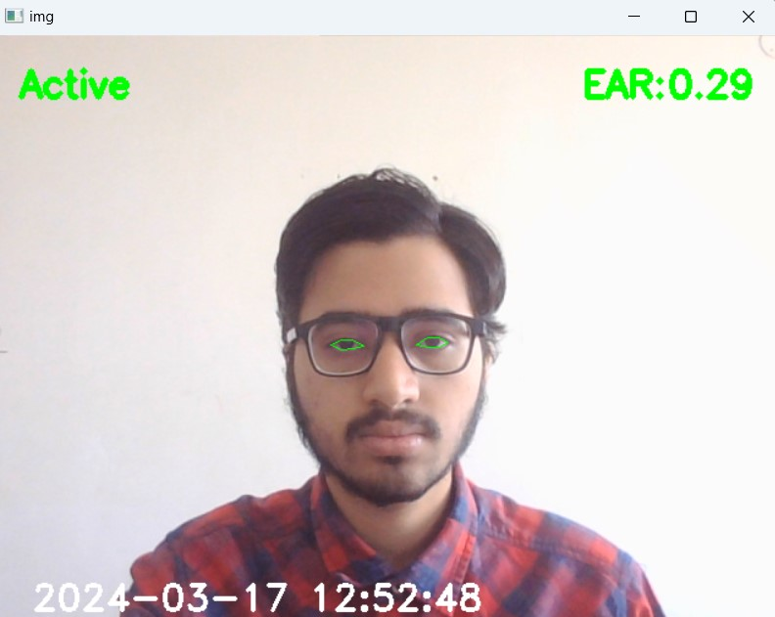
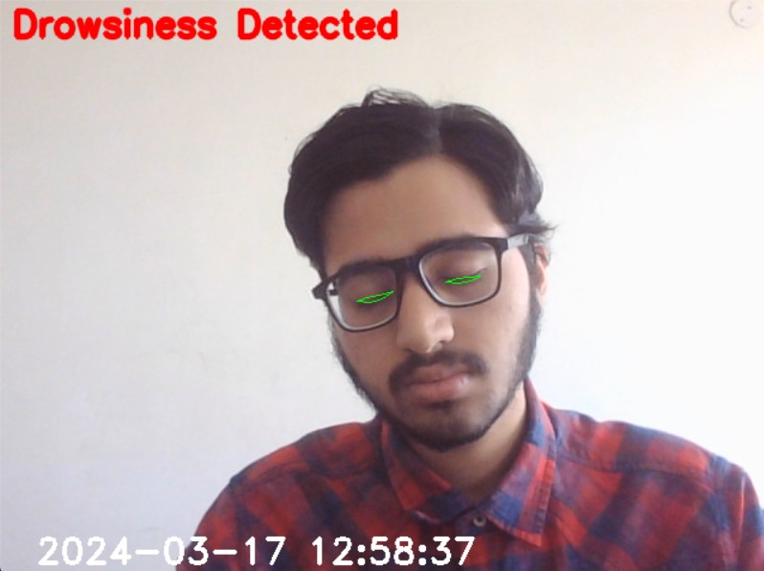
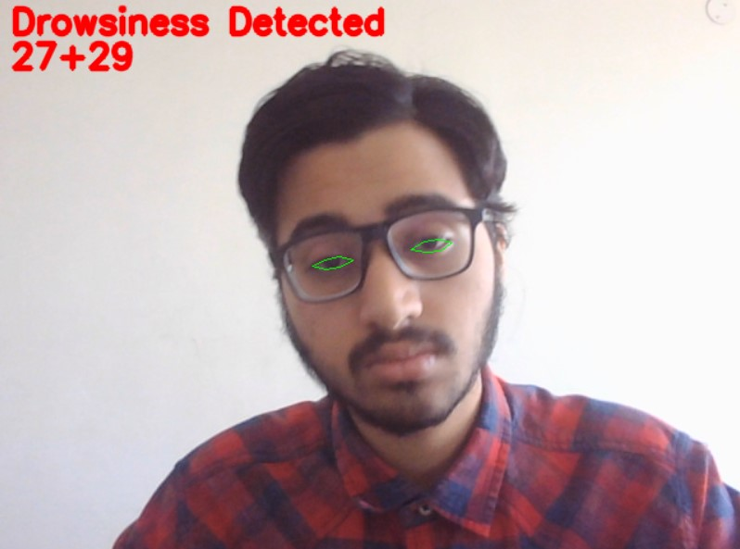
ACTIVE WINDOW
DROWSINESS WINDOW

Slide 6
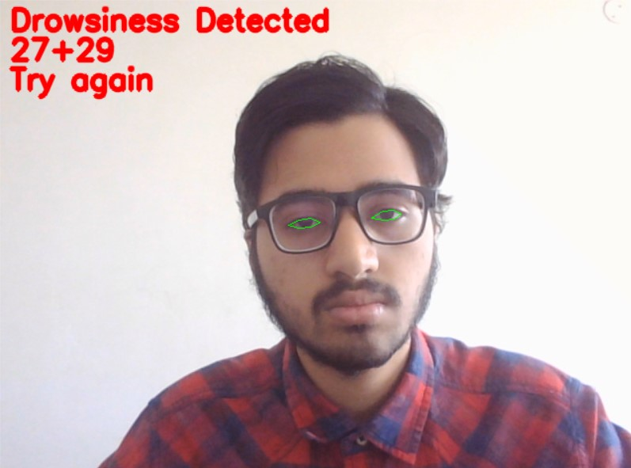
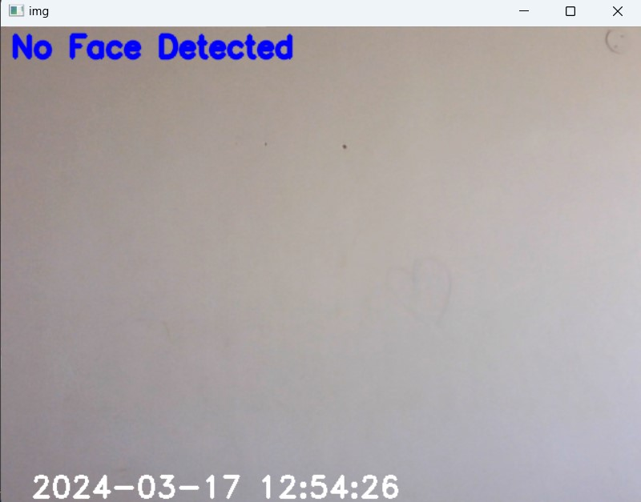
WRONG ANSWER WINDOW
NO FACE WINDOW

Slide 7
Market Report: Drowsiness Detection Models
Automotive Industry
Workforce Management
Transportation Sector
.
MEDICAL FIELD
e.

Slide 8

Problem statement 2: create a model that reconstructs 3D scenes from 2D images
Description and Idea conceived:
Our approach commences by acquiring depth images, enabling us to extract crucial depth information. Subsequently, leveraging this depth data, we derive a set of 3D points corresponding to the spatial layout of the depicted scene or object. Employing triangulation techniques, we carefully reconstruct the 3D model. Finally, we present the generated 3D model through visualization tools, facilitating comprehensive analysis and interpretation of the underlying data.

Slide 9
KEY FEATURES
image Loading and Processing:
Image to NumPy Array
Depth Map Generation
Mesh Generation
Using triangular
faces
Mesh Saving

Slide 10
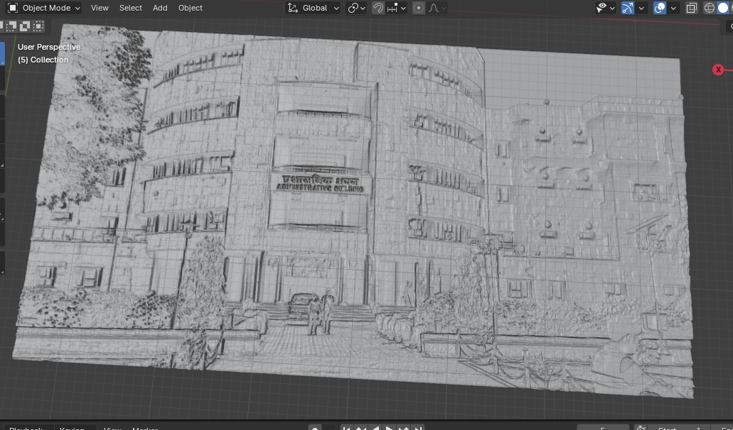
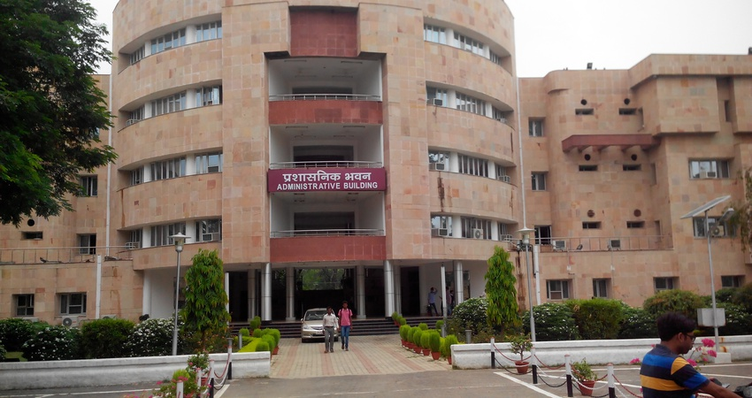
Some 3D models we created
Source image
3 D MODEL

Slide 11
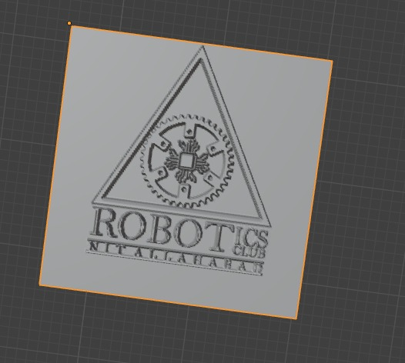

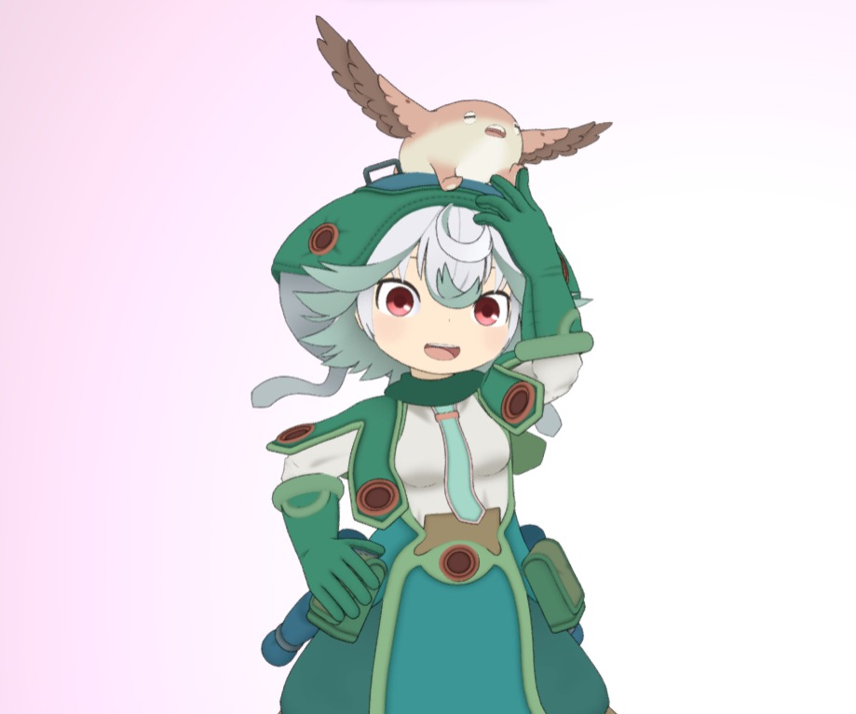
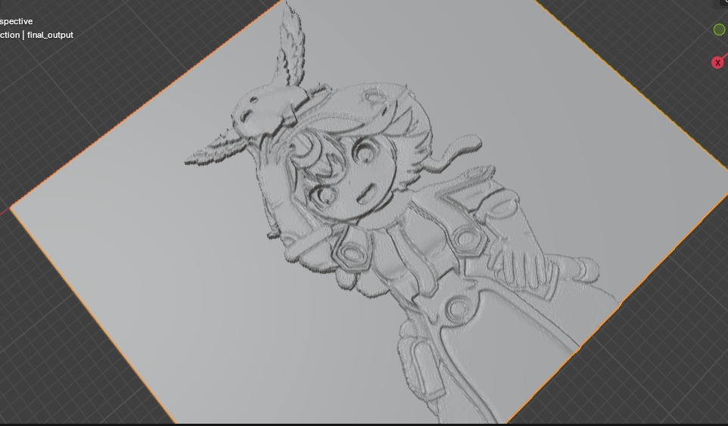

Slide 12
Market Report: 2D to 3D Image
3D Printing and Design
E-commerce and Product Visualization
Film and Animation
Computational Efficiency
EDUCATION FIELD
.
Multi-View Input
e.

Slide 13
THANK YOU! ☺

